Slide 1
ERTS Final Assessment – Task 1 (Template)
Harry Liu - fx19583
Stephanie Lin - pt19585
Daiyun Chen - mt20768

Slide 2
Guidance for this presentation
This presentation is assessed and will form your mark for the first task
Keep explanations concise, use screenshots or bullet points to present information
You will have 5 minutes to present this, this is a strict limit and you will be timed
Use the time as you feel appropriate
Use your code and robot to help you present what you have done
You will also be asked questions after your presentation
Delete this slide

Slide 3
Practical elements
Show that the robot can move around effectively in both modes of operations
Show that you have made use of the LED & Switches
Red light: motor stops
White: forward
Blue: right
Yellow: left
Green: backward
Sky Blue: Auto mode
Pink: Free mode
Is there nay difference in operation when you robot works in polling mode and interrupt mode?
In Interrupt, the motor immediately stops(auto mode) or changes direction(free motion mode) when bump switch is hit
In Polling, the motor shows a delay when bump is pressed because the program only checks for the bump after the prefined loop is finished.

Slide 4
Interrupts
How do you implement operation of robot with polling? Why?
Using a while loop that sequentially runs for instructions that is given.
And checks the bump switch one by one to see if it has hit something.
How do you implement operation of robot with interrupts? Why?
Using a while loop that continuously runs the predefined route and immediately stops the current process to deal with interrupt when interrupt arises, and when interrupt is finished, return to the execution of the predefined route.
How have you kept the ISRs minimal?
Clear and memory stack after each interrupt
Disable interrupt when polling is used

Slide 5
Delays
Where have delays been used? Why?
In the mode_selection function, to wait for user to input select mode.
To prevent the user pressing too fast when selecting mode.
Also used when changing direction, to slow down the turning process.

Slide 6
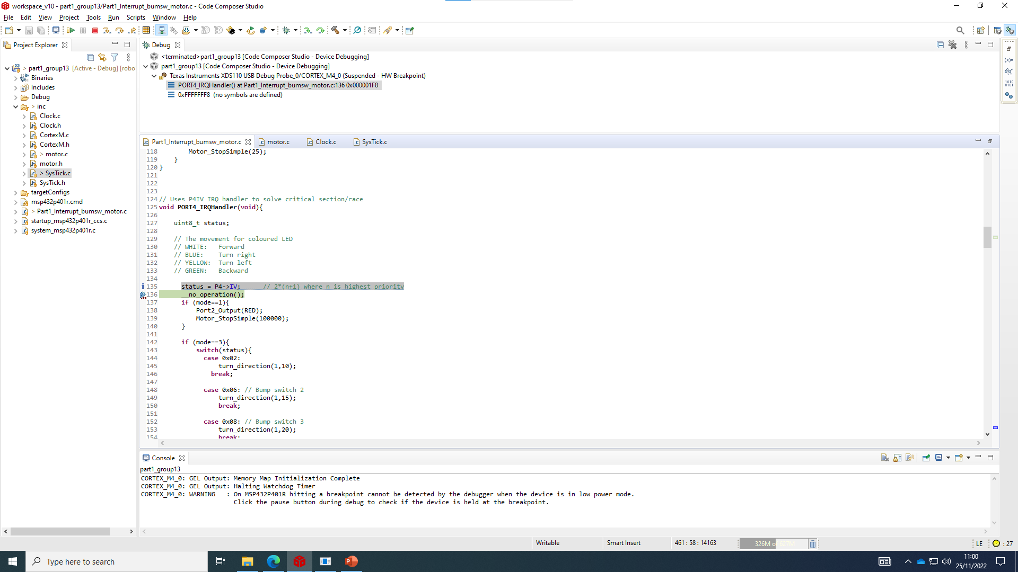
CPU Usage
How have you measured the CPU utilization?

Slide 7
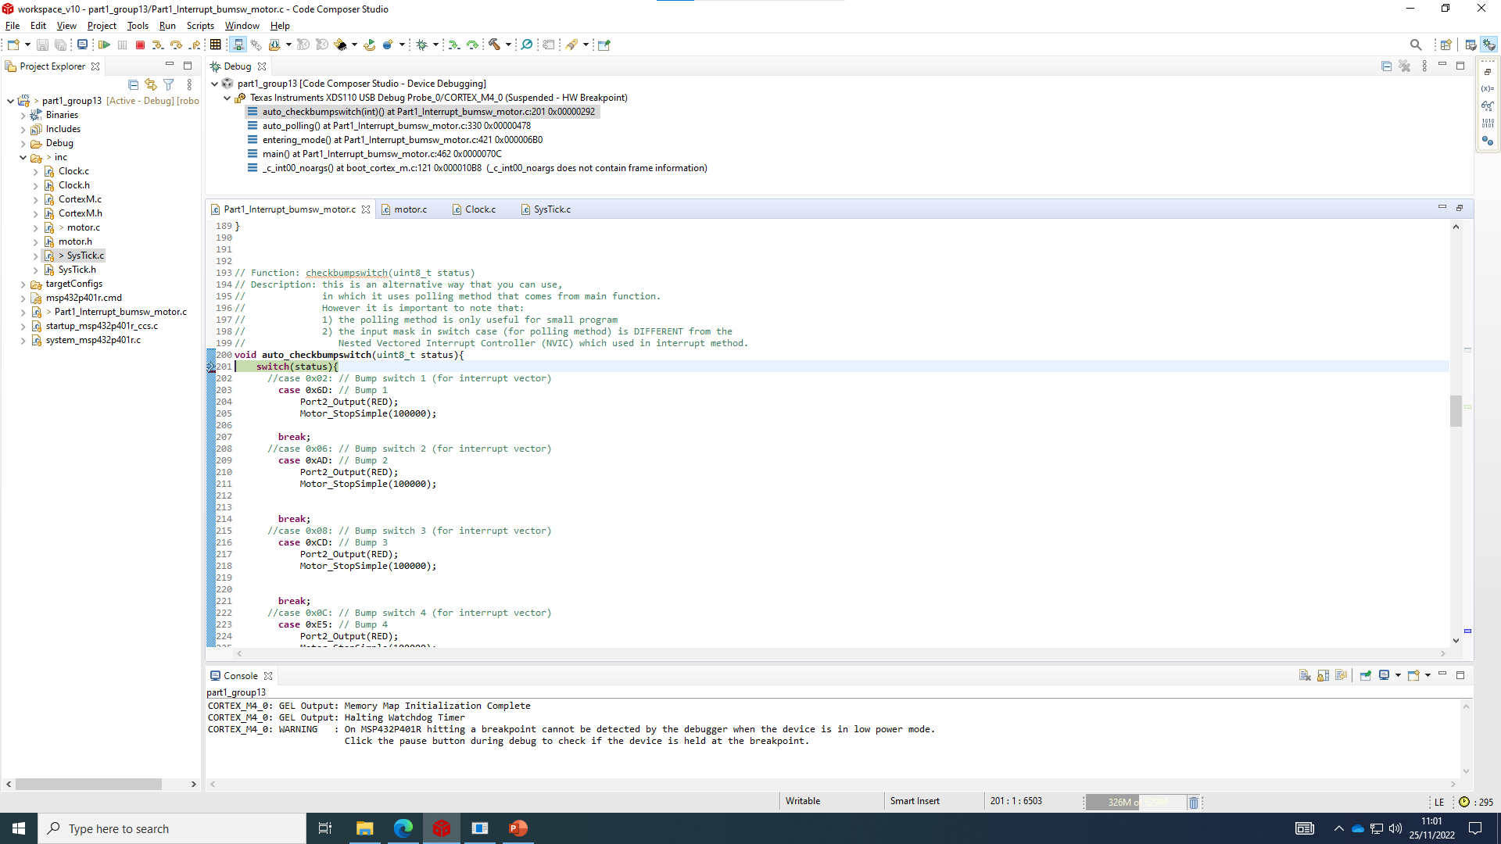
CPU Usage
How have you measured the CPU utilization?

